Slide 1
How to extract custom attributes from ACC/BIM360 Docs
Example workflow:
Get Folder Information
Get Folder Content
Get Custom Attributes
1
Flip on to the next page for the sample code

Slide 2
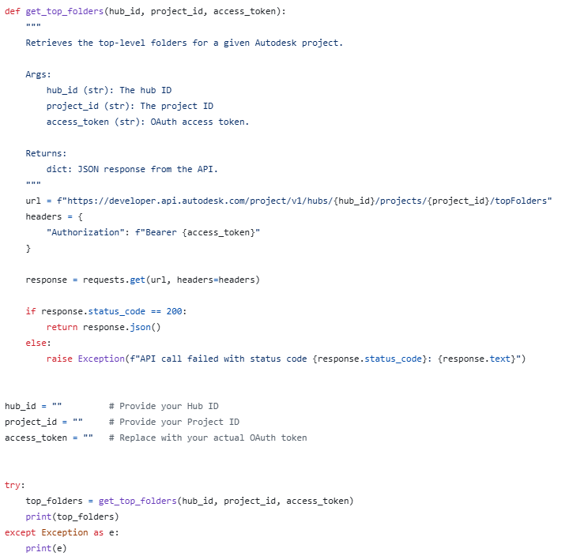
Get Folder Information
2

Slide 3
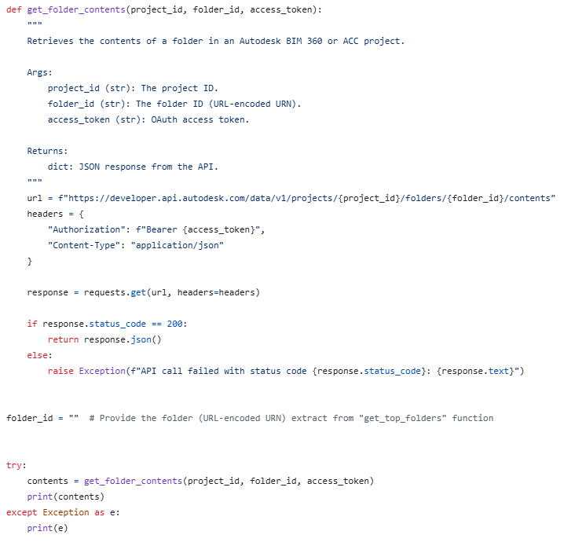
Get Folder Content
3

Slide 4
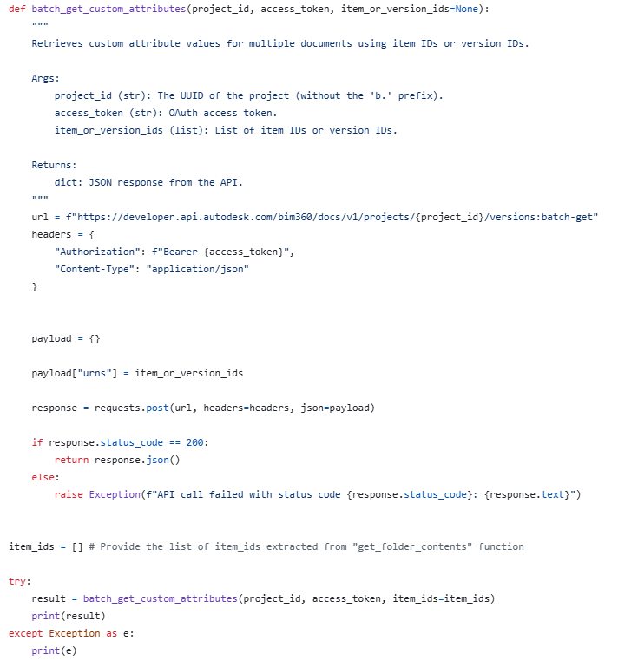
Get Custom Attributes
4

Slide 5

Click here to download the complete code from GitHub
5

